Slide 1
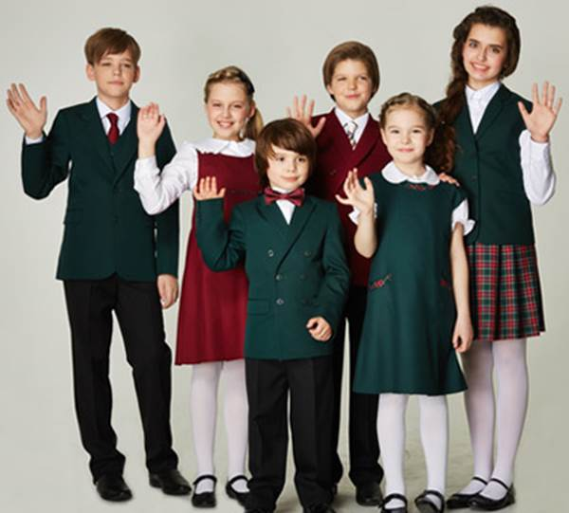

Slide 2
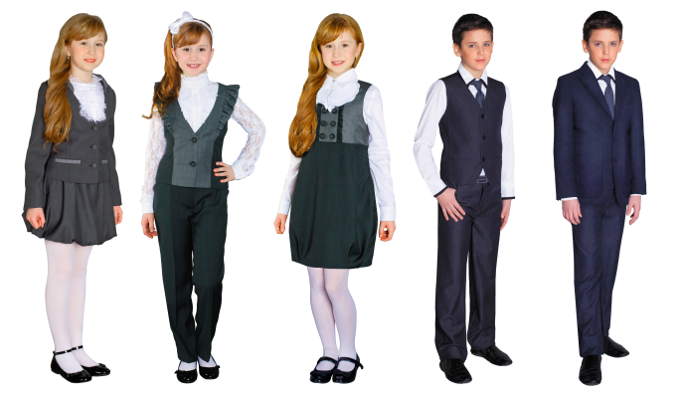

Slide 3
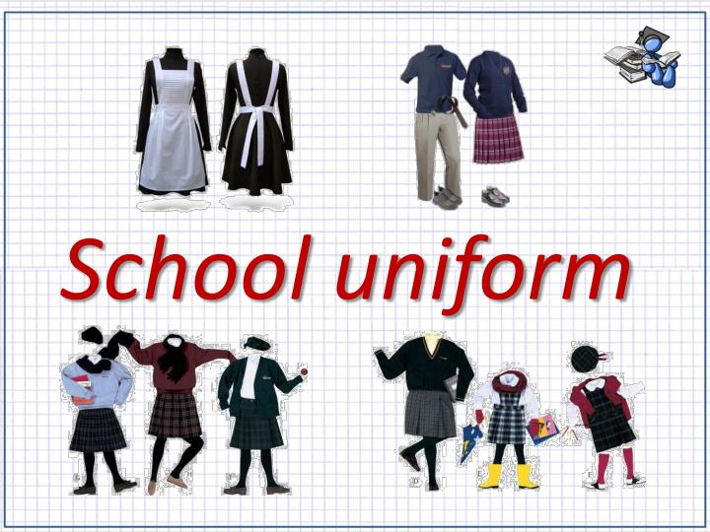
The theme of our lesson is

Slide 4
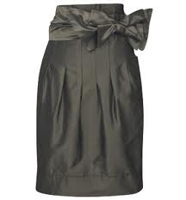
CLOTHES
  skirt

Slide 5
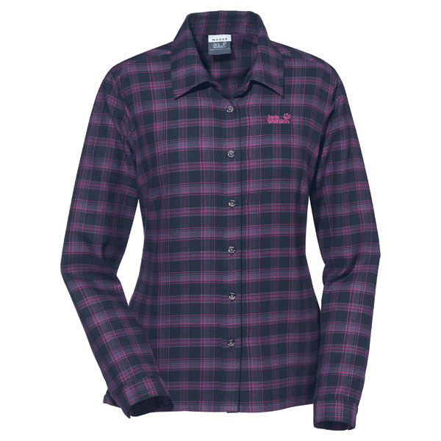
shirt

Slide 6
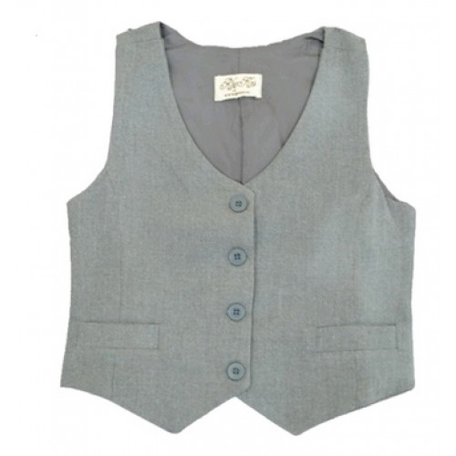
waistcoat

Slide 7
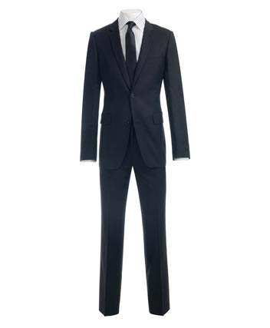
suit

Slide 8
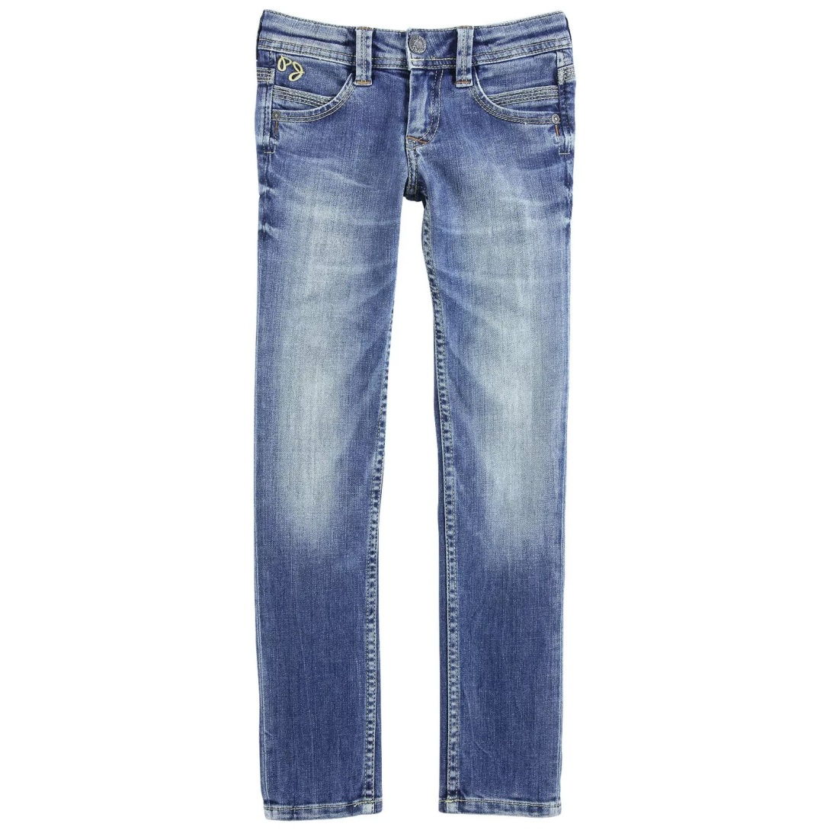
jeans

Slide 9
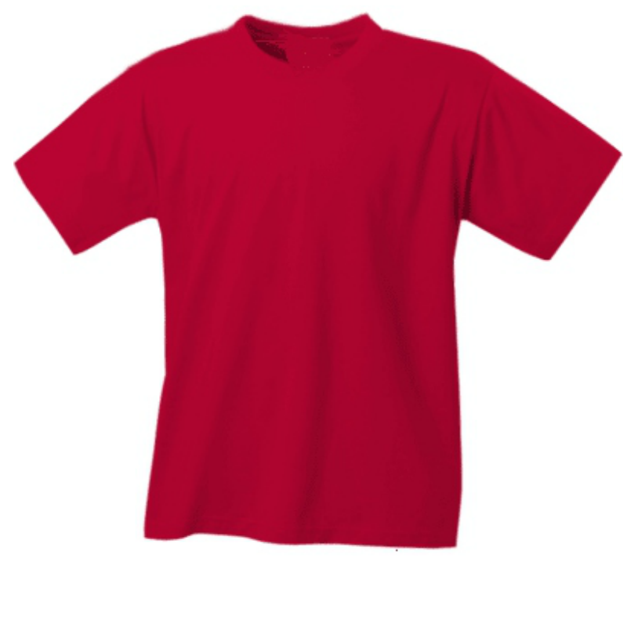
T-shirt

Slide 10
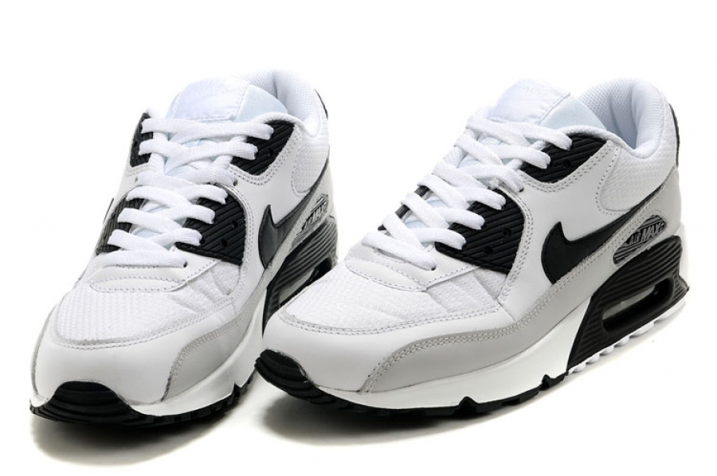
trainers

Slide 11
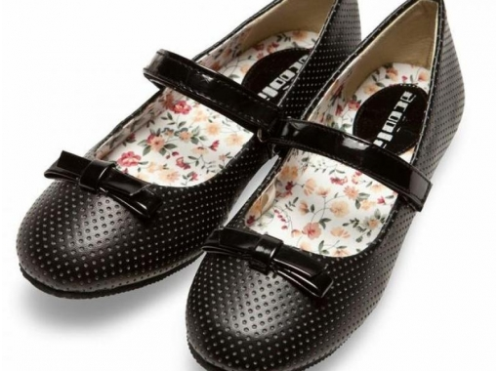
shoes

Slide 12
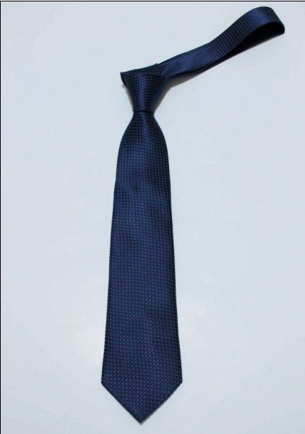
tie

Slide 13
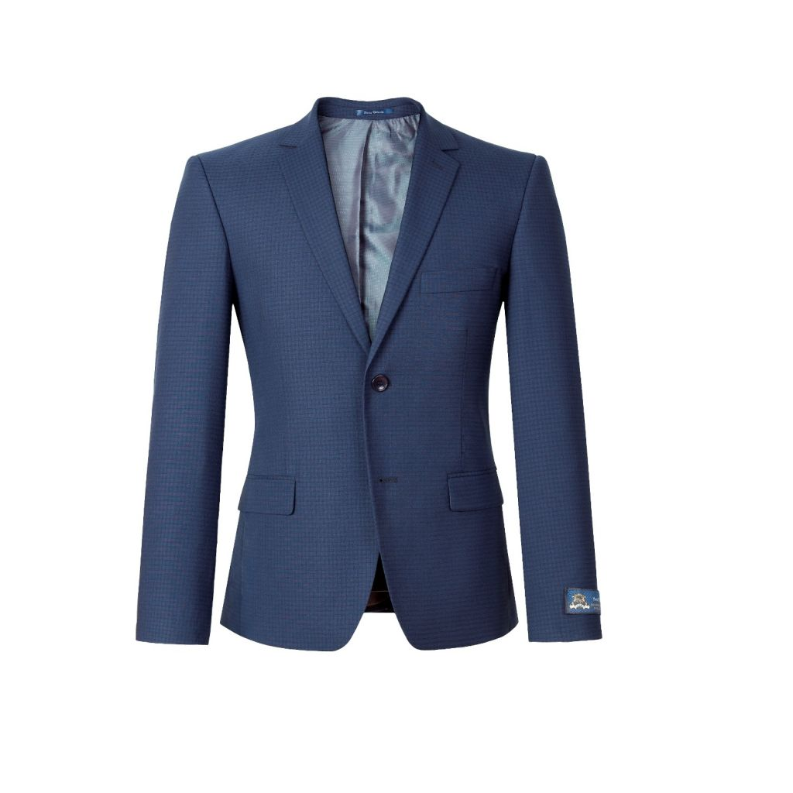
jacket

Slide 14
Find the odd words in each list
Fashion | Tights | Hat
Take off | Coat | Clothes
Put on | Overcoat | Sweater
Try on | Cap | Sweater
Wear | Jeans | Blouse
Like | Boots | Skirt

Slide 15
Use the following expressions:
This picture shows…
In the picture we can see…
He/She has…and…on
He/She is wearing…
He/She also has…
The colour of his/her …is…
He/she is looking great, attractive, nice, good,bad…because…

Slide 16
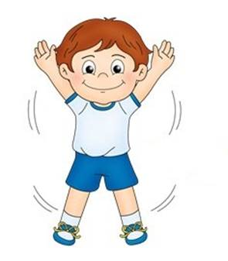
Let’s do these exercises
Hands on knees.
Hands behind you,
if you please;
Hands on shoulders,
Touch your shoulders,
Now your nose,
Now your hair and now your toes;
Hands up high in the air,
Down at your sides, and touch your hair;
Hands up high as before,
Now clap your hands, one-two-three-four!
/

Slide 17
Repeat after me in chorus
dress code
to take away
to go ahead
to suppress
in favour of
to back
logo
plain
brand name
trendy

Slide 18
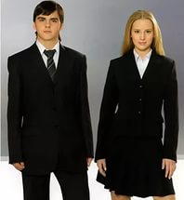
Thank you for attention

